Slide 1

Introduction to Cloud Computing
Week 11
Azure Cloud Integration Services and Tools
CS-4037
Muhammad Sudais
muhammad.sudais.v@nu.edu.pk

Slide 2
CHAPTER 10 Azure Cloud Integration Services and Tools
|Learning Microsoft Azure

Slide 3
Introduction to Cloud Integration
What is Cloud Integration?
Connecting multiple cloud-based or on-premises systems and applications.
Real-time data sharing and synchronization across different platforms.
Why Cloud Integration Matters:
Ensures cohesive operations and data visibility.
Enables businesses to leverage multiple cloud services efficiently.
Benefits of Cloud Integration:
Improved Collaboration: Teams can access unified data in real time, reducing silos.
Enhanced Data Accuracy: Real-time data flow minimizes inconsistencies and ensures up-to-date information.
Better Decision-Making: Accurate, timely data helps leaders make informed business decisions.
Scalability and Flexibility: As businesses grow, integrated systems can scale without major disruptions.

Slide 4
Types of Cloud Integration
Application-to-Application (A2A): Integrating different software applications, e.g., CRM and ERP.
Data Integration: Synchronizing data across different databases and storage services.
Cloud-to-Cloud Integration: Bridging different cloud services, such as AWS and Azure.
On-Premises to Cloud: Connecting legacy systems with modern cloud applications.
Hybrid Cloud Integration: Combining public and private clouds with on-premises data centers.
Cloud-to-Mobile: Ensuring data and functionality flow from cloud applications to mobile apps.
Cloud-to-Business (B2B): Facilitating partnerships by sharing data securely between businesses.

Slide 5
Why Cloud Integration
Reliability & Scalability:
Reliability: Ensures minimal downtime and operational continuity across integrated systems.
Scalability: Easily adjusts to increased demand without compromising performance.
Tools for Monitoring:
Azure Monitor: Real-time observability and analytics.
Application Insights: Detects performance issues, monitors app health, and tracks dependencies.
Improved Efficiency & Cost Savings
Automation Reduces Manual Effort: Reduces human errors by automating repetitive processes.
Cost Efficiency: No need for expensive on-premises infrastructure. Pay for what you use (cloud economics).
Example: Moving from manual data entry between CRM and ERP to automated sync using Azure Logic Apps.
Business Agility
Real-Time Decision-Making: Unified data from integrated systems enables businesses to adapt quickly.
Competitive Edge: Faster response to market changes through integrated, flexible systems.
Example: Retailers can adjust inventory and supply chains in real time using data from integrated systems.

Slide 6
Azure Integration Solutions
Azure Logic Apps:
Orchestrates and automates workflows.
Examples: Integration with Office 365, Salesforce, or Slack.
Azure Functions:
Event-driven compute service
runs code in response to triggers (HTTP requests, events).
Event Grid:
Enables event-based workflows.
Example: Real-time notifications across services.
Service Bus:
Message broker service for reliable message delivery across systems.

Slide 7
Web APIs in Cloud Integration
Types of Web APIs:
Public APIs: Open APIs available for external developers to build integrations.
Partner APIs: Private APIs restricted to specific business partners for B2B integrations.
Internal APIs: Used for connecting internal services within a company (e.g., HR systems, financial systems).
Composite APIs: Combine multiple APIs into a single API, simplifying communication.
Benefits of Web APIs
Simplifies Integration: Web APIs make it easier to connect disparate systems with minimal custom development.
Extends Functionality: APIs allow third-party developers to build new functionalities on top of your services.
Enables Innovation: Fast, secure API integration accelerates the development of new features and services.
Example: A payment gateway API that integrates with an e-commerce platform.
API Management Lifecycle:
Development: Define and design the API with proper versioning and documentation.
Deployment: Host APIs securely and manage access.
Maintenance: Monitor performance, manage security (OAuth, tokens), and ensure API reliability.
Azure API Management: Tool for publishing, securing, and analyzing APIs.

Slide 8
Introduction to Azure API Management (APIM)
Definition: A flexible integration service for designing, developing, and managing APIs across different environments.
Features:
Supports full API lifecycle: design, deployment, management, and retirement.
Works in hybrid and multi-cloud scenarios.
Use Cases:
Connecting applications and systems in a secure manner.
Enabling external access to internal systems via APIs.

Slide 9
Azure API Management Pricing Tiers
Consumption Tier:
Best for: Serverless or lightweight apps.
Pricing: Pay-per-use, no SLA.
Limitations: Not suitable for US Government or 21Vianet environments.
Developer Tier:
Best for: Non-production environments, testing, and development.
Pricing: Low-cost, no SLA.
Basic Tier:
Best for: Entry-level production use.
Standard Tier:
Best for: Medium-sized applications with typical production needs.
Premium Tier:
Best for: Large enterprises with high demand.
Features: Multi-region support, VNet integration.

Slide 10
Benefits of Azure API Management
Complete API Lifecycle:
From design to retirement, APIM helps manage APIs efficiently.
Security:
Protects APIs using certificates, OAuth, JWT tokens.
API gateways allow for throttling, quotas, and caching.
Integration:
Supports web, mobile, IoT, B2B apps.
Legacy System Modernization:
Expose legacy apps through modern cloud APIs.

Slide 11
Azure API Management Components
API Gateway: Routes requests to backend services and enforces security policies.
API Management Plane: Manage API lifecycle, configure quotas, rate limits, and monitor performance.
Developer Portal: Enables API testing, documentation, and account management for API users.

Slide 12
Azure API Management Key Features
API Gateway:
First point of contact for client requests.
Handles routing, security, and caching.
Management Plane:
Comprehensive API management, monitoring, and analytics.
Supports CLI, PowerShell, SDKs for different languages.
Developer Portal:
Open-source customizable portal.
Supports API testing, documentation, and key management.

Slide 13
Integration with Azure Services
Azure Entra ID: Authentication and security for API requests.
Azure Key Vault: Store and manage API secrets and certificates.
Azure Monitor: Logs, alerts, and monitoring for API usage and performance.
Azure Functions & Logic Apps: Event-driven compute and low-code integration workflows.
Networking: API protection with VNet, private endpoints, and Application Gateway.

Slide 14
Azure Logic Apps
Definition: Low-code/no-code integration tool for automating workflows.
Features:
Connects with on-premises and cloud services.
Visual designer for building workflows.
Benefits of Azure Logic Apps:
Integration: Connect multiple systems without coding.
Automation: Automate business processes like sending alerts or processing orders.
Wide Connectors: Integrates with services like Azure Storage, Databases, and external SaaS services.
Azure Logic Apps Components:
Workflows: Define the steps for automating a task.
Triggers: Start workflows based on specific conditions or events.
Actions: Steps taken within a workflow (e.g., sending an email).
Connectors: Integrations with different services (e.g., Office 365, Salesforce).

Slide 15
Introduction to Cloud Messaging
Cloud Integration: Connecting applications, APIs, and web services.
Messaging Brokers: Enable data transfer between decoupled systems.
Formats Supported: Plain text, XML, JSON.

Slide 16
Azure Service Bus
Definition: A cloud-based messaging service acting as an intermediary.
Purpose: Reliable, secure, and scalable messaging for application integration.
Supports: Asynchronous message transfer through queues and topics.
Key Features of Azure Service Bus:
Intermediary Broker: Facilitates data transfer between applications.
Parallel Competing Consumers: Multiple apps can read from the same queue.
Reliable Messaging: Ensures flexibility, scalability, and reliability.
Advanced Features
Auto-forwarding: Chains messages between topics/queues.
Duplicate Detection: Avoids duplicate message processing.
Dead-letter Queue (DLQ): Captures message failures for review.
Prefetch & Message Deferral: Optimizes message processing.

Slide 17
Service Bus Architecture
Service Bus Architecture: Queues
FIFO (First In, First Out): Message delivery order.
Decoupled Messaging: Applications interact without direct connection.
Use Case: Web, mobile apps, or services communicating with back-end systems.
Service Bus Architecture: Topics & Subscriptions
Publisher-Subscriber Pattern: Enables one-to-many communication.
Topics: Message stream publisher.
Subscriptions: Filters messages for specific subscribers.
Use Case Examples: News platforms, stock trading apps, IoT solutions.
Comparing Queues vs Topics
Queue: Single point-to-point message delivery.
Topic: Broadcasts messages to multiple subscribers.
Key Differences: One-to-one vs One-to-many communication.

Slide 18
Azure Service Bus Integrations
Integration with Azure Functions:
Message Processing: Azure Functions can trigger actions from queue messages.
Serverless Event Handling: Trigger Azure Functions for real-time processing.
Use Cases: Customer order processing, task completion triggers.
Integration with Logic Apps: Automate workflows with low-code solutions.
Azure Event Grid: Respond to events in real-time.
Dataverse & Power Platform: Decoupled architecture for business processes.

Slide 19
Azure Service Bus - Considerations
Pricing and Tier Considerations
Standard Tier: 64 KB to 265 KB message size.
Premium Tier: Supports transactions and messages up to 100 MB.
Cost-Benefit Analysis: Choose based on your application needs.
Service Bus vs Azure Storage Queue
When to Choose Service Bus: FIFO guarantee, message transactions, message batching.
When to Choose Azure Storage Queue: Simpler queue storage, large message sizes (up to 80 GB).

Slide 20
Azure Service Bus – Use Cases & Benefits
Real-World Use Cases
IoT Solutions: Managing data from multiple devices.
News Platforms: Delivering categorized updates to users.
Stock Trading Apps: Real-time notifications on user-selected stocks.
Benefits of Service Bus
Reliability: Guaranteed message delivery.
Scalability: Scalable across distributed systems.
Security: Secure message handling through Azure platform.

Slide 21
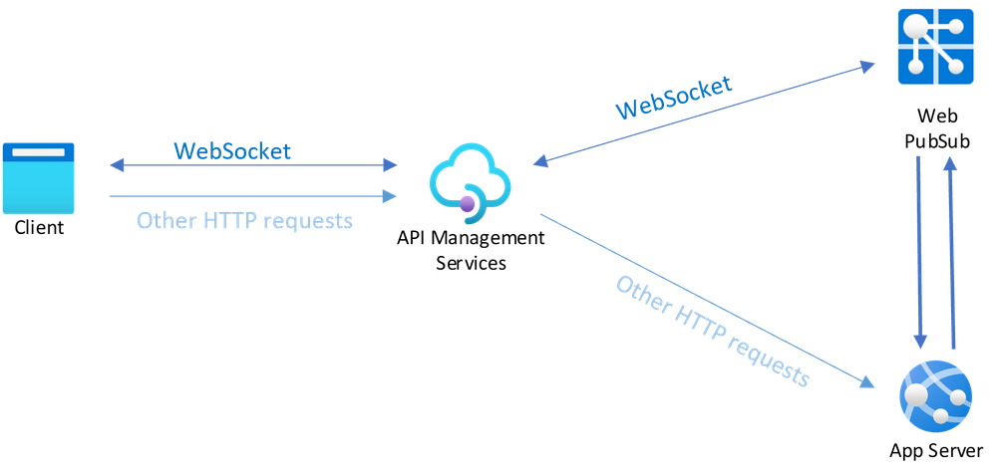
Introduction to Azure Web PubSub
Overview:
Managed service enabling real-time messaging
Supports WebSocket communication for instant updates
Ideal for chat apps, live dashboards, and IoT monitoring
Publish-subscribe messaging architecture
Azure Web PubSub Architecture
Web client sends HTTP request → Server accepts request
WebSocket connection enables bidirectional communication
Client-server handshake for real-time message exchange
Illustration of WebSocket connection

Slide 22
Web PubSub Pricing Tiers
Free Tier:
Up to 20 connections, 20,000 messages/day
Max Units: 1, 99.9% SLA
Ideal for testing and development
Standard Tier:
Up to 1,000 connections, 1 million free messages
Supports unlimited messages, message broadcasting, and ordering
Max Units: 100, 99.9% SLA
Premium Tier:
Enhanced reliability, autoscaling, custom domain
Availability zone support for enterprise workloads

Slide 23
Web PubSub – Use Cases & Benefits
Use Cases for Azure Web PubSub:
Real-time messaging and live dashboards
Live auctions, gaming, and voting polls
Collaborative platforms (e.g., live pair programming)
Live chat and online customer support
IoT monitoring and real-time notifications
Benefits of Web PubSub:
Real-time updates via WebSockets
Scalability and high availability
Easy integration with web, mobile, and IoT applications
Pub/sub messaging pattern for async communication
Built-in security features

Slide 24
Web PubSub – Components & Workflow
Azure Web PubSub Components:
Server: Manages connections, events, and messages
Message: Data format (text, JSON, binary), 1MB max size
Hub: Grouping of client connections for specific use cases (e.g., chat, notifications)
Group: Allows clients to join/leave group sessions dynamically
Event Handlers & Listeners: Manage client events and server-side logic
Typical Web PubSub Workflow:
Client connects → Service invokes server with Cloud Events → Server responds via REST API → Client receives server response

Slide 25
Introduction to Azure Event Grid
What is Azure Event Grid?
Event-based, fully managed pub-sub service
Allows apps to respond to changes and events
Reactive programming model for distributed systems
Routes events to multiple subscribers
Key Features of Azure Event Grid:
Event-driven notification and messaging delivery
HTTP-based event support for both Azure and external APIs
Simplifies event-based applications with reliable delivery
Supports custom event handling for specific triggers

Slide 26
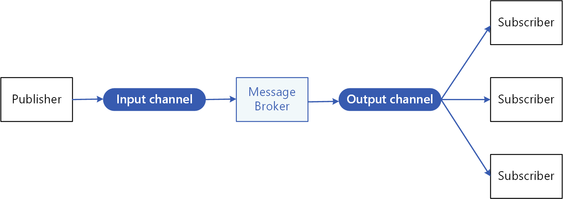
Event Grid Architecture
Publisher sends events to input channel
Message broker replicates events to output channel
Subscribers receive events asynchronously

Slide 27
Event Grid Use Cases
Send emails on Azure VM changes
Real-time notifications for workflows, automation, and triggers
Reactive programming for scalable applications
Ideal for serverless applications, microservices, and distributed systems

Slide 28
Comparing Web PubSub and Event Grid
Web PubSub:
Real-time messaging via WebSockets
Ideal for client-server bidirectional communication (e.g., chat, dashboards)
Event Grid:
Event-based pub-sub model
Ideal for reactive programming and event notifications (e.g., workflow automation)

Slide 29
Integration with Other Azure Services
Web PubSub and Event Grid both integrate seamlessly with Azure services (e.g., Azure Functions, Logic Apps)
Real-time messaging and event-driven architectures can enhance serverless applications

